Slide 1
Holocaust
Made by: Matej Perišić, Roko Banovac, Luka Rukavina, Petar Aladić, 1d, 23. 1. 2023.

Slide 2
What is Holocaust?
State persecution and genocide of different ethnic, religious and political groups of people during the World War II.
It lasted from 1941. to 1945.
Most of the victims of the Holocaust died in Nazi concentration camps, of which there were about 42,500

Slide 3
Meaning of Holocaust
The word holocaust comes from the Greek word for the burnt offerings that they offered to their gods.
The Hebrew name is "shoah", which translates to catastrophe

Slide 4
Proceeding of Holocaust
Anti-Semitism began with the arrival of Adolf Hitler and the Nazi movement to power in Germany in 1933
In September 1935, the Nürnberg Laws were introduced, which negatively related to Jews
Autumn 1941 - the deportation of Jews to the East begins

Slide 5
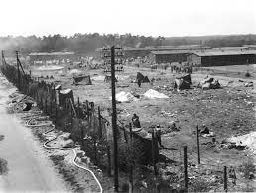
Proceeding of Holocaust
Anti-Semitism began with the arrival of Adolf Hitler and the Nazi movement to power in Germany in 1933
In September 1935, the Nürnberg Laws were introduced, which negatively related to Jews
Autumn 1941 - the deportation of Jews to the East begins

Slide 6
Examples of antisemitism
Jews lost their German citizenship
It was forbidden for Jews to stay in public places
Women and children were killed in the process, while men became slaves
They may not perform any public service, nor can their children attend public schools

Slide 7
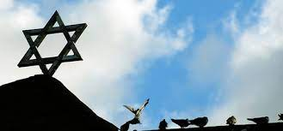
Examples of antisemitism
Jews lost their German citizenship
It was forbidden for Jews to stay in public places
Women and children were killed in the process, while men became slaves
They may not perform any public service, nor can their children attend public schools

Slide 8
The Holocaust in the Independent State of Croatia :
Between 70,000 and 100,000 prisoners were killed in Jasenovac, the only concentration camp in Europe that was not under German administration

Slide 9
Consequences
A huge number of victims: from 9 to 11 million, 5.29 to 6 million were Jews
The second nation with the largest number of victims: "Roma"(Gypsies) - from 220 to 800 thousand
Other victims of the Holocaust: Poles, Russians, Slavic people, prisoners of war ,homosexuals, Jehovah’s Witnesses, black people, dissidents, politicals opponents of the Nazis and members of other minority groups
Holocaust Remembrance Day: January 27

Slide 10
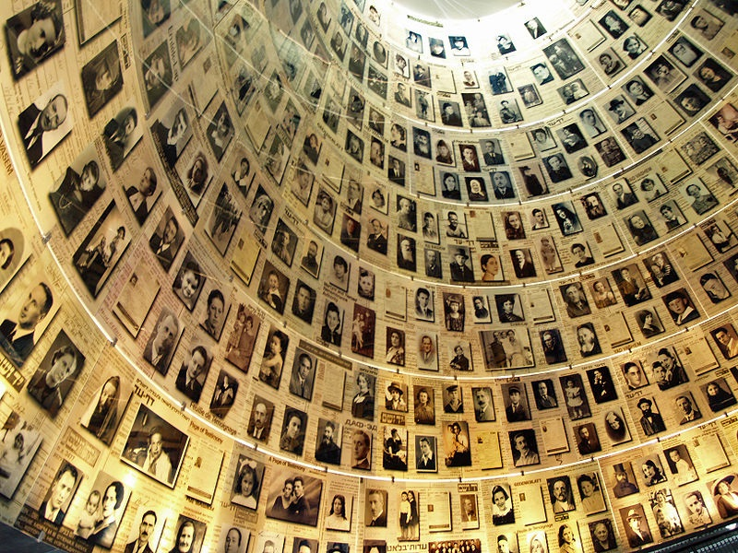
Consequences
A huge number of victims: from 9 to 11 million, 5.29 to 6 million were Jews
The second nation with the largest number of victims: "Roma"(Gypsies) - from 220 to 800 thousand
Other victims of the Holocaust: Poles, Russians, Slavic people, prisoners of war ,homosexuals, Jehovah’s Witnesses, black people, dissidents, politicals opponents of the Nazis and members of other minority groups
Holocaust Remembrance Day: January 27

Slide 11
Sources
https://hr.wikipedia.org/wiki/Holokaust
https://www.profil-klett.hr/holokaust-zlocin-koji-je-obiljezio-20-stoljece
https://mojzagreb.info/svijet/nacisti-davidovu-zvijezdu-podigli-na-razinu-idovskog-simbola
https://annefrank.freetls.fastly.net/media/filer_public_thumbnails/filer_public/4a/bc/4abcc67c-89cc-40e1-b8af-7b8e090ec9a4/iwm_035.jpg__1536x1536_q85_subsampling-2.jpg
https://www.sabor.hr/hr/27-sijecnja-medunarodni-dan-sjecanja-na-zrtve-holokausta

Slide 12
Thank you for your attention!

