Slide 1
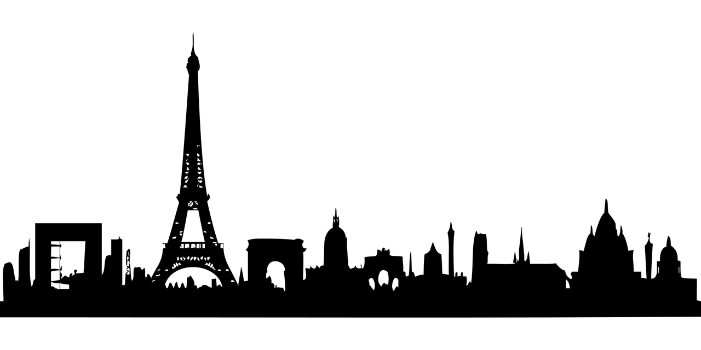
Paris - the city of love!

Slide 2
History and location
Under the Roman Empire around 300BC , the city of Paris was named “Lutetia”.
Paris is located in northern central France, in a north-bending arc of the river Seine whose crest includes two islands, which form the oldest part of the city. The city is spread widely on both banks of the river.
The population of Paris is 2.2 million as of the beginning of 2019, all living in the city limits that span around 105 square kilometres. To walk from the North side of Paris to the South, it will take you around 135 minutes.
Paris is divided into 20 distinct, which start at the centre and work their way out.

Slide 3
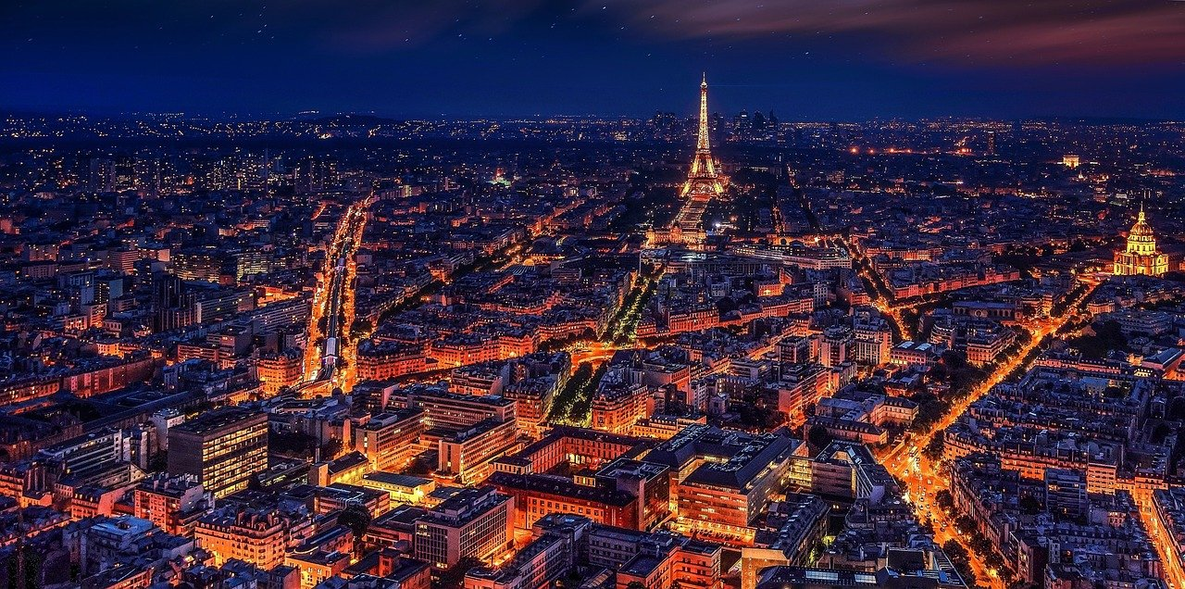
“A walk about Paris will provide lessons in history, beauty, and in the point of life.” -Thomas Jefferson -
Known as the “City of Light” or the “City of Love,” the streets of Paris overflow with culture, art, beauty, and history. No matter what you do, strolling in the streets of Paris, climbing the many steps of Sacré-Cœur, standing before the Eiffel Tower in awe, or searching out the best crepes along the Seine, Paris is a city that captures the hearts of millions ever year.

Slide 4
Arc de Triomphe
One of Paris’ most visited public landmarks in the incredible Arc de Triomphe, which lies at the very end of the Champs-Élysées at the Place Charles de Gaulle. Here, you can take in iconic neoclassical architecture, climb to the top for sweeping views of the Champs-Élysées and beyond, or pay your respects at the Tomb of the Unknown Soldier.

Slide 5
Louvre Museum
With over nine million visitors annually, the Louvre Museum is the most popular museum on the planet. It’s famously home to the Mona Lisa, but over 35,000 pieces of art are on display. In the museum’s entire collection, there are over 460,000 pieces of art.

Slide 6
The Eiffel Tower
Parisian landmark that is also a technological masterpiece in building-construction history.
When the French government was organizing the International Exposition of 1889 to celebrate the centenary of the French Revolution, a competition was held for designs for a suitable monument.
Built by bridge engineer Gustave Eiffel.
The tower itself is 300 metres (984 feet) high.
The Eiffel Tower was the tallest structure in the world until the topping off of the Chrysler Building in New York City in 1929.
The sight of this unique landmark will put you in romantic enchantment. It's no wonder that thousands of people have already proposed at this magical place. Especially after dark, the atmosphere is breathtaking. The twinkling lights were originally meant to be on for ten minutes every hour, however, this now only happens for five minutes on the hour every evening until 1am.

Slide 7
"Mur des je t'aime"
The most beautiful sentence in the world was immortalized in Paris in 311 languages, on the "Mur des je t'aime". The wall of love is, so to say, a must for all couples in love who come to Paris. The wall was designed by the artists Frédéric Baron and Claire Kito. It is located on the Place des Abbesses, on the Montmartre Hill. The Montmartre Hill is the highest natural elevation in the city.
https://upload.wikimedia.org/wikipedia/commons/c/c2/Mur_des_Je_t%27Aime_%40_Square_Jehan-Rictus_%40_Montmartre_%40_Paris_18_%2832949174486%29.jpg
Attribution: Guilhem Vellut from Paris, France, CC BY 2.0 <https://creativecommons.org/licenses/by/2.0>, via Wikimedia Commons

Slide 8
The Pont des Arts
Before nightfall you should definitely watch the sunset, preferably from the Pont des Arts. This bridge is famous for its "love locks". It is considered to be one of the most romantic places in Paris. Until recently, thousands of lovers have sworn their love here, with love locks.

Slide 9
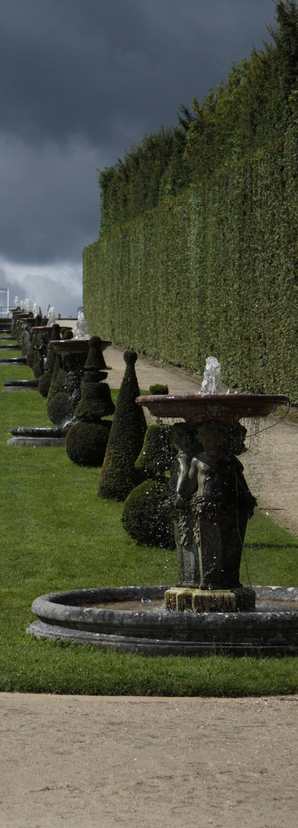
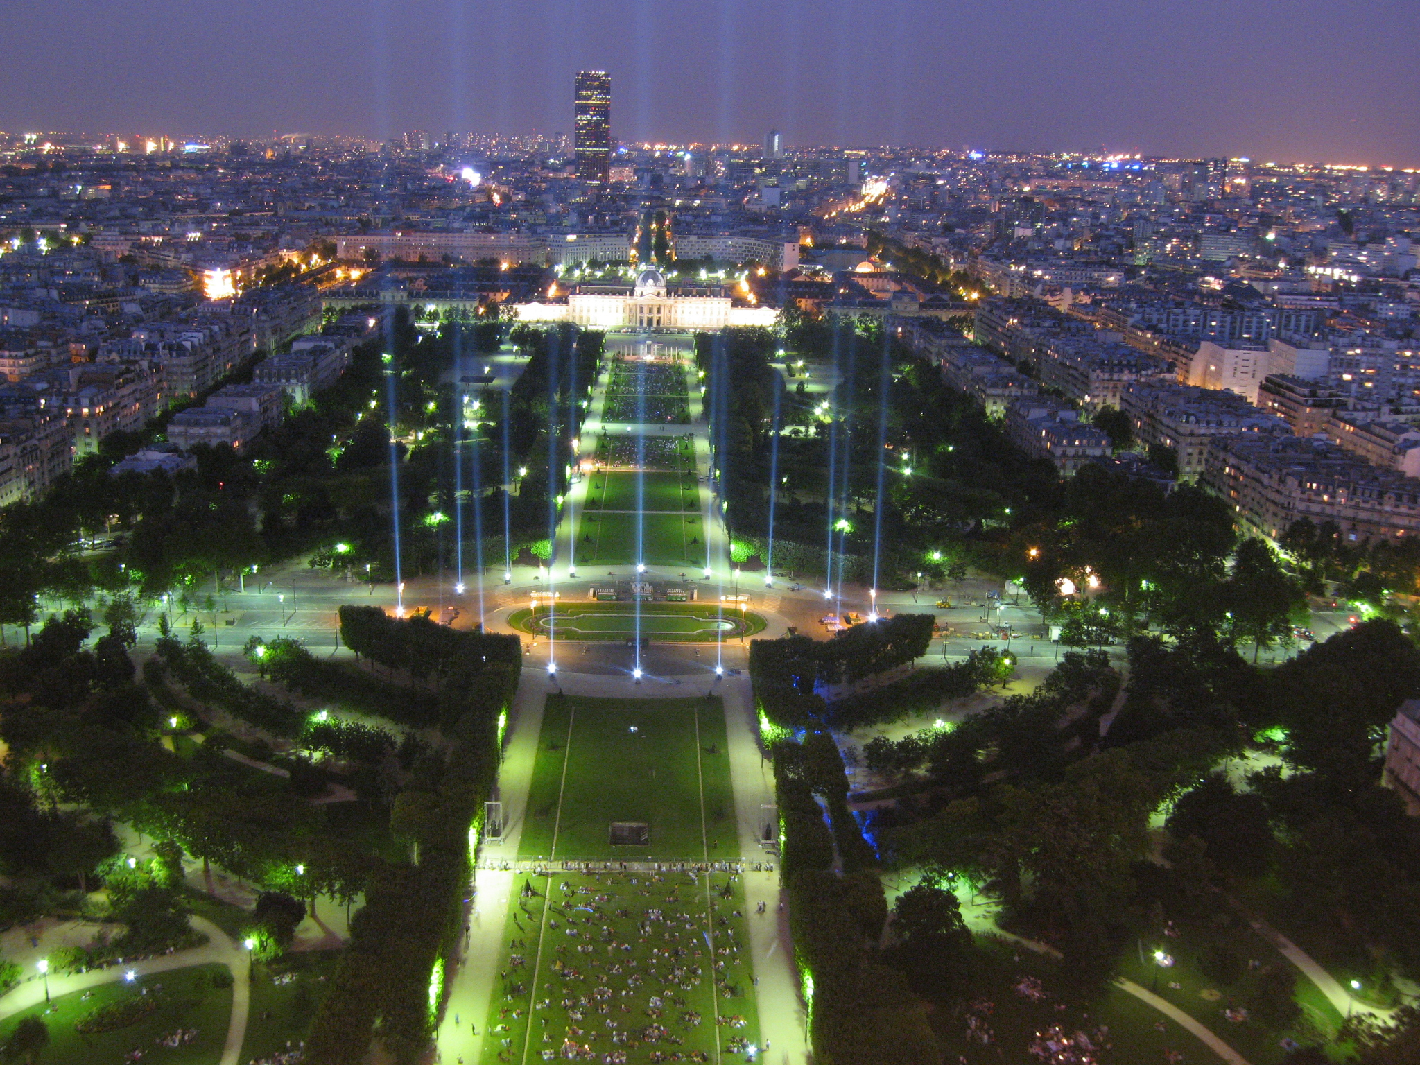
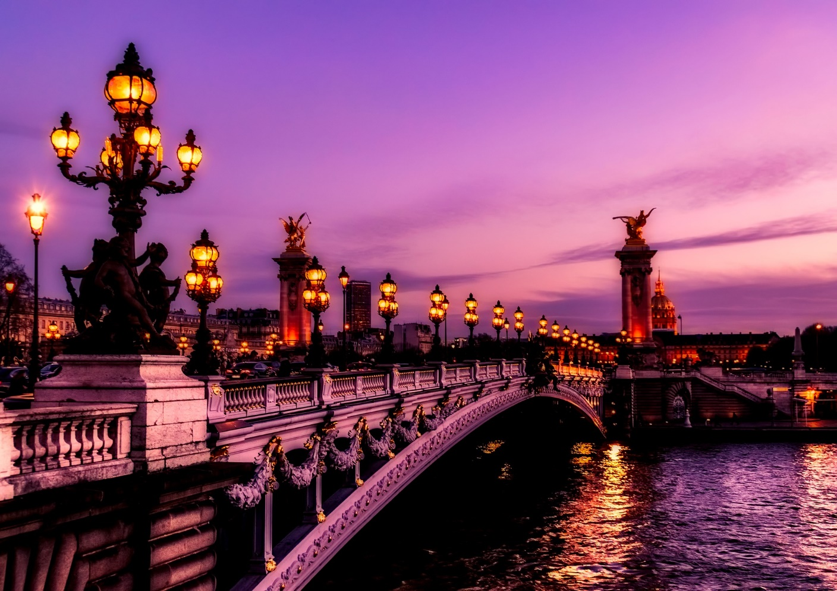
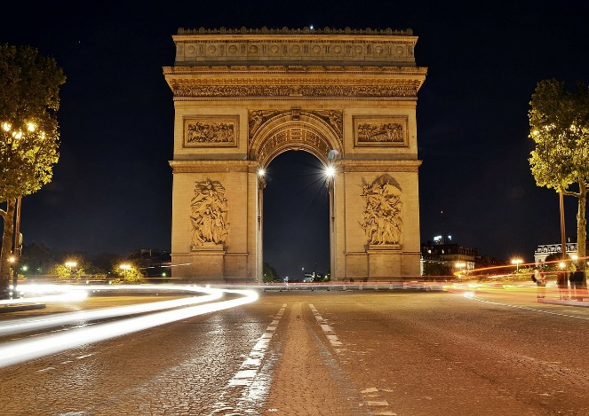
Proposal place
There’s no better place to propose to your partner than in the City of Love. People come from all over to solidify their love during their visit. Just being in Paris is romantic enough for proposal. In order to make the event even more special, one should pick out an ideal spot to pop the question.
Some creative proposal ideas in Paris are:
Champ de Mars at night with the Eiffel Tower light show in the background
Arc de Triomphe at sunset with the sun setting perfectly between the columns
Gardens of Versailles right after exiting the palace with amazing views
Seine River romantic sunset dinner cruise

Slide 10
Fun facts!!!
The main bell of the Notre Dame Cathedral is named Emmanuel and weighs over 13 tonnes.
Visitors to the Eiffel Tower have to climb 1,665 steps to reach the top – unless they take the elevator!
Paris is a great destination for kids! There are over 450 parks and gardens in the city, that’s a lot of space to run wild!
There are more dogs in Paris than children. Parisians love their furry friends.
The Tour de France is the world’s most famous cycling event, and finishes on the historical stretch of the Champs-Élysée in Paris.
The most popular way that locals get around Paris is by their extensive Metro train system. Around 5 million people per day use it, and after Moscow, it’s the busiest underground network in Europe.
The famous “Bloody Mary” cocktail originated in Paris at the Ritz Hotel, by who other than famed novelist Ernest Hemingway himself!
New York’s iconic Statue of Liberty was a gift from the French. But that doesn’t mean that France didn’t make a few for themselves. There are currently ten Statues of Liberty in France, with five in Paris alone.

Slide 11
Were you listening to us?

